Slide 1


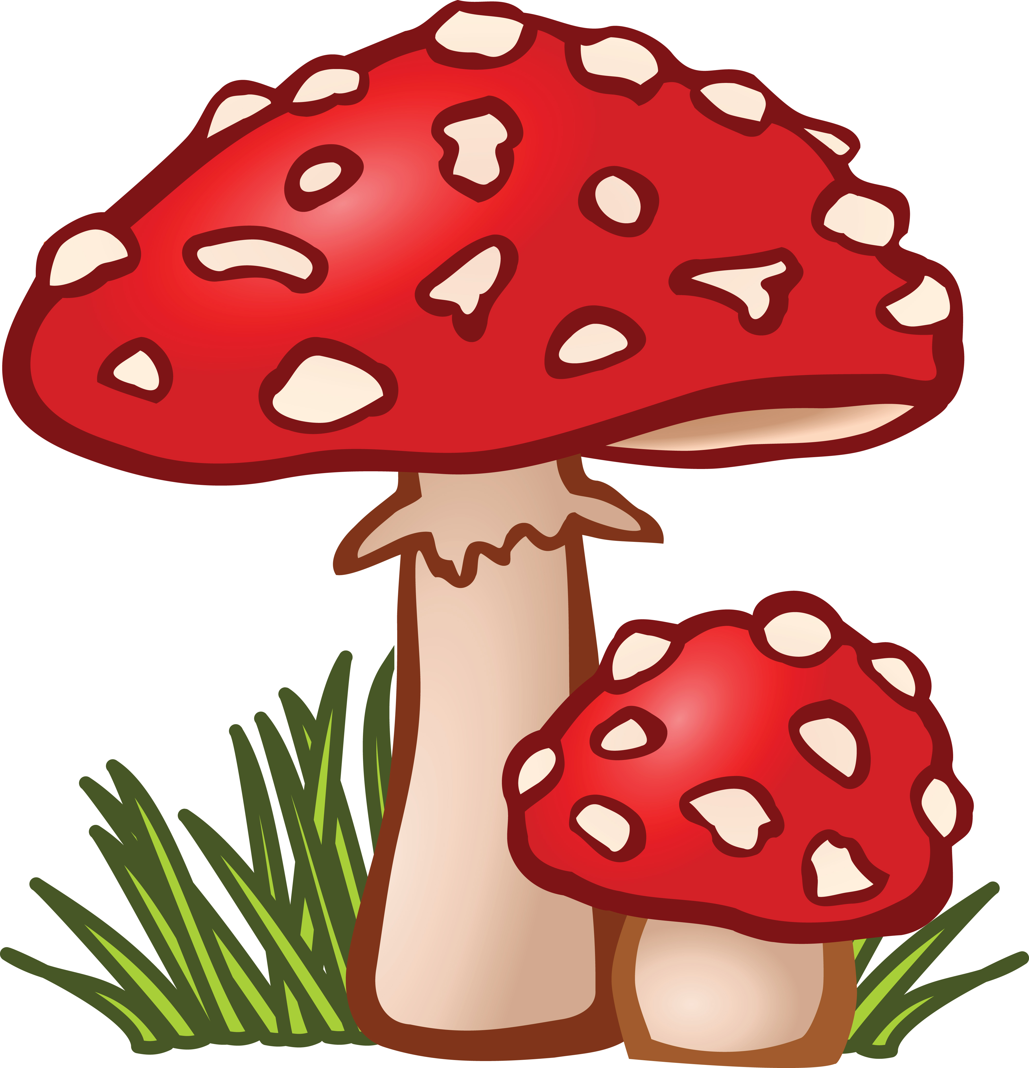
DETAILED PROJECT REPORT
Mushroom
Classifications
Safe to eat or deadly poison?
By Rohan Kadam And Vijay kamble

Slide 2

PROJECT DETAIL
Project Title
Mushroom Classification
Technologies
Machine Learning Technology
Domain
Agriculture
level
Intermediate

Slide 3
Objective
The main goal is to predict which
mushroom is poisonous & which is edible

Slide 4
PROBLEM STATEMENT
The Audubon Society Field Guide to North American Mushrooms contains descriptions of hypothetical samples corresponding to 23 species of gilled mushrooms in the Agaricus and Lepiota Family Mushroom (1981). Each species is labelled as either definitely edible, definitely poisonous, or maybe edible but not recommended. This last category was merged with the toxic category. The Guide asserts unequivocally that there is no simple rule for judging a mushroom's edibility, such as "leaflets three, leave it be" for Poisonous Oak and Ivy.
The main goal is to predict which mushroom is poisonous & which is edible.

Slide 5
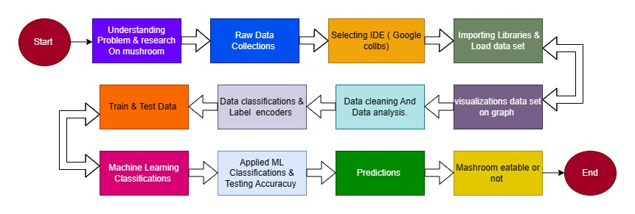
The Architecture

Slide 6
DATASET INFORMATION
The dataset used in this project contains 8124 instances of mushrooms with 23 features like cap-shape, cap-surface, cap-color, bruises, odor, etc.
Attribute Information:
(classes: edible=e, poisonous=p)
cap-shape: bell=b,conical=c,convex=x,flat=f, knobbed=k,sunken=s
cap-surface: fibrous=f,grooves=g,scaly=y,smooth=s
cap-color: brown=n,buff=b,cinnamon=c,gray=g,green=r,pink=p,purple=u,red=e,white=w,yellow=y
bruises: bruises=t,no=f
odor: almond=a,anise=l,creosote=c,fishy=y,foul=f,musty=m,none=n,pungent=p,spicy=s
gill-attachment: attached=a,descending=d,free=f,notched=n
gill-spacing: close=c,crowded=w,distant=d
gill-size: broad=b,narrow=n
gill-color: black=k,brown=n,buff=b,chocolate=h,gray=g, green=r,orange=o,pink=p,purple=u,red=e,white=w,yellow=y

Slide 7
stalk-shape: enlarging=e,tapering=t
stalk-root: bulbous=b,club=c,cup=u,equal=e,rhizomorphs=z,rooted=r,missing=?
stalk-surface-above-ring: fibrous=f,scaly=y,silky=k,smooth=s
stalk-surface-below-ring: fibrous=f,scaly=y,silky=k,smooth=s
stalk-color-above-ring: brown=n,buff=b,cinnamon=c,gray=g,orange=o,pink=p,red=e,white=w,yellow=y
stalk-color-below-ring: brown=n,buff=b,cinnamon=c,gray=g,orange=o,pink=p,red=e,white=w,yellow=y
veil-type: partial=p,universal=u
veil-color: brown=n,orange=o,white=w,yellow=y
ring-number : none=n,one=o,two=t
ring-type : cobwebby=c,evanescent=e,flaring=f,large=l,none=n,pendant=p,sheathing=s,zone=z
spore-print-color : black=k,brown=n,buff=b,chocolate=h,green=r,orange=o,purple=u,white=w,yellow=y
population: abundant=a,clustered=c,numerous=n,scattered=s,several=v,solitary=y
habitat: grasses=g,leaves=l,meadows=m,paths=p,urban=u,waste=w,woods=d

Slide 8
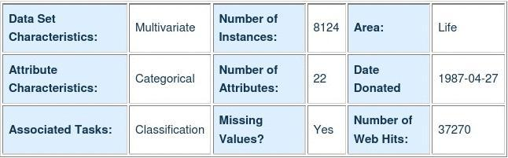
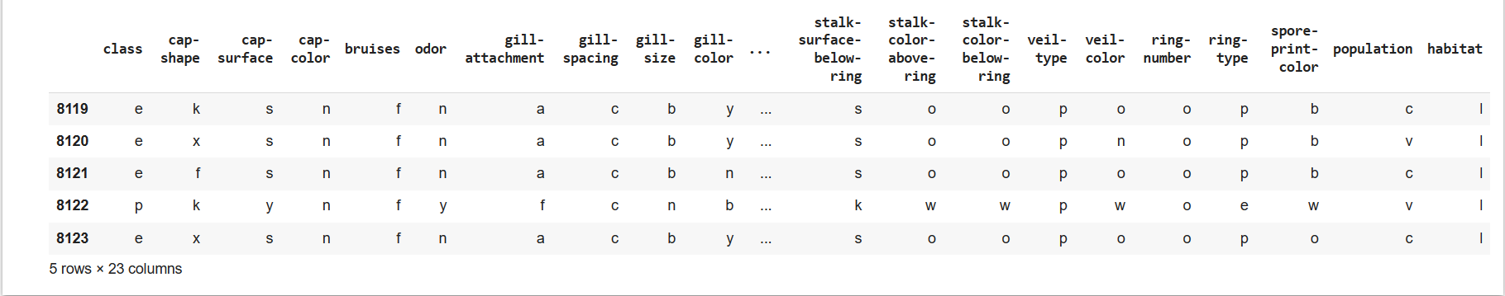
The data set is given in csv file
Column and about data set as follows :

Slide 9

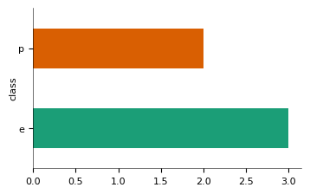
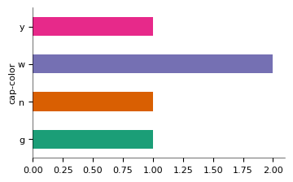
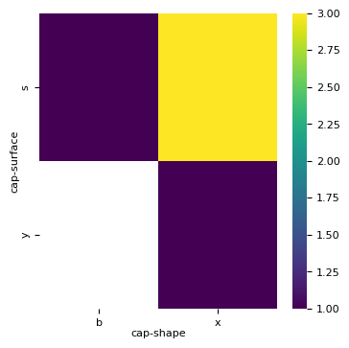
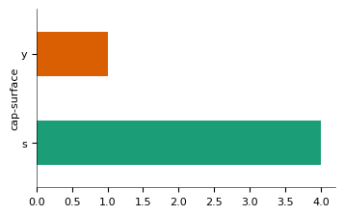
2-D Categorical Graphs

Slide 10
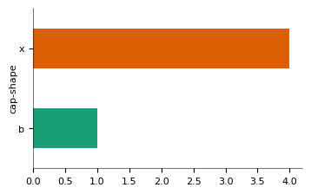
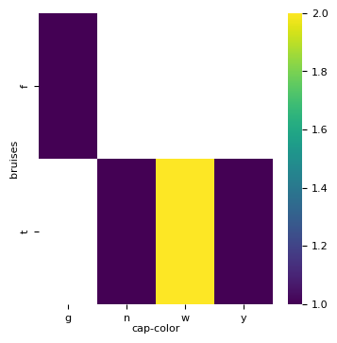
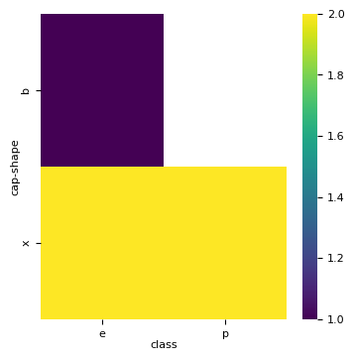
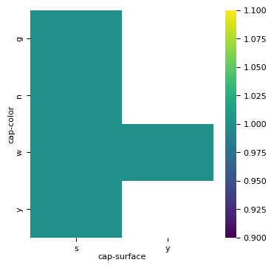

Slide 11
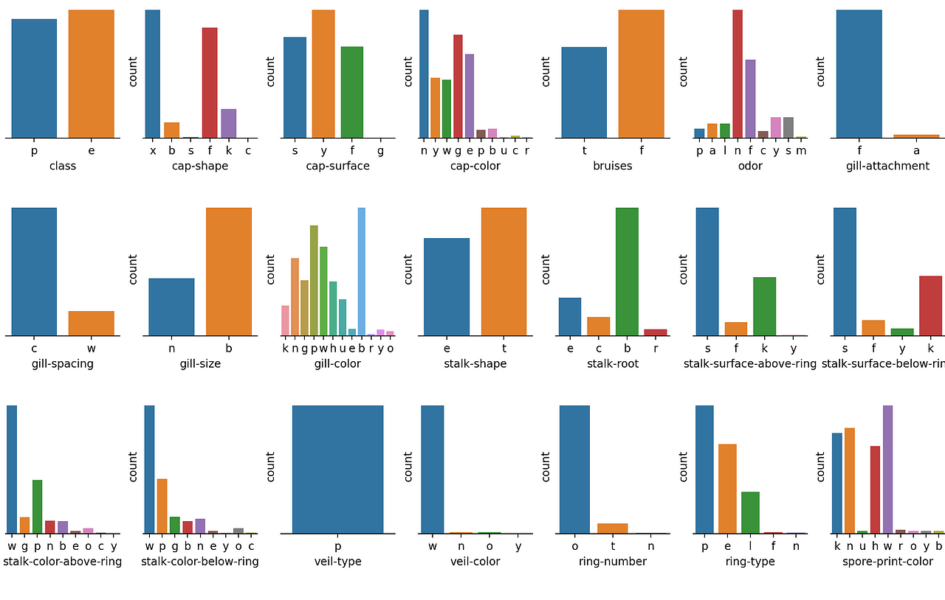

Slide 12
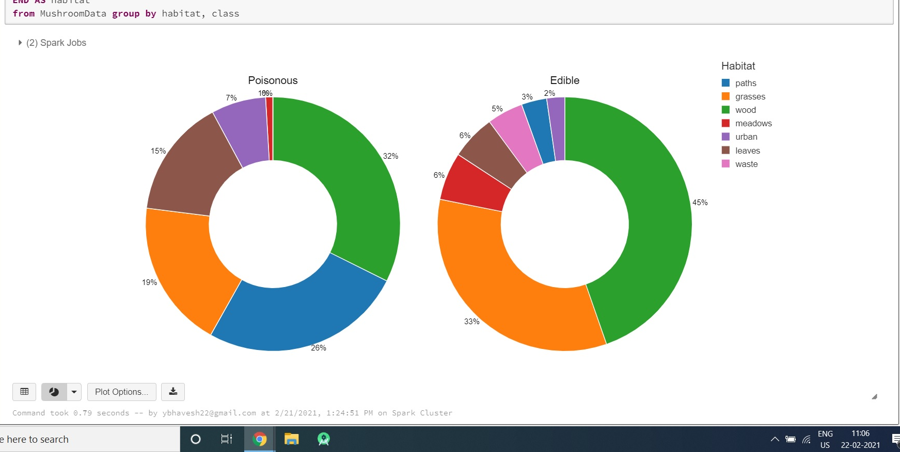
Poision And Edible Class
Part 02
YOUR TITLE HERE

Slide 13
Machine Learning Classification Test Result
Sr.no | Classifications | Result
1 | #Random Forest Classification | 100%
2 | #Decision tree classification | 100%
3 | #naive bayes classfications | 91.88%
4 | #SVM Classification | 100%
5 | #K-Nearest neighbour | 100%
6 | #Logistic Regressions | 94%

Slide 14
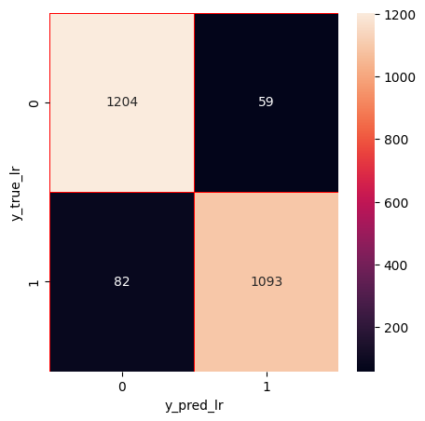
Confusion Matrix

Slide 15
Conclusion
From the confusion matrix, we saw that our train and test data is balanced.
Most of classfication methods hit 100% accuracy with this dataset.
In conclusion, the application of machine learning in mushroom classification has demonstrated its remarkable potential in automating and enhancing the accuracy of identifying mushroom species. Through the utilization of advanced algorithms and vast datasets, we have witnessed the development of robust models capable of distinguishing between edible and toxic mushrooms with a high degree of confidence. As technology continues to advance and more research is conducted, we can anticipate even greater strides in the accuracy and efficiency of mushroom classification using machine learning. This, in turn, will contribute to safer mushroom foraging practices, greater understanding of fungal biodiversity, and the preservation of ecosystems.

Slide 16
Thank You

